Slide 1


Slide 2

What is Tensorflow?
Tensorflow is 1st Ranked Machine Learning platform and made by Google Brain Team.
It supports CUDA(GPU-Acceleration)
It Has Python & C/C++ interface.
But usually we use python.

Slide 3
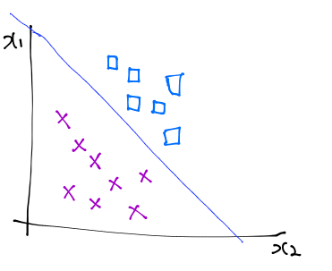

Binary Classification(Logistic Regression)
If we want separate X and ㅁ
We use just one h(x) which found by sigmoid function.
So, Y’s range is 0 or 1.
We called this Binary Classification.

Slide 4
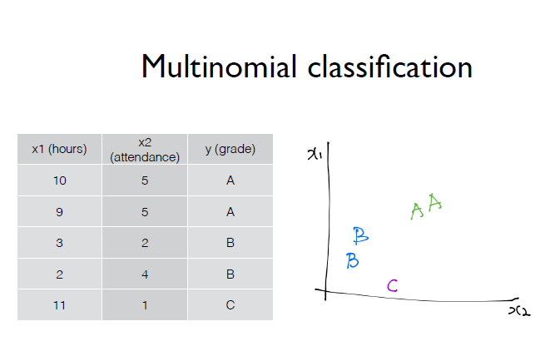
Multinomial Classification
If we want separate group by grade (such as A,B or C)
How to classificate in this problem?
Our Y value are probably like this (0 or 1 or 2)
We called this classification
“Multinomial Classification”

Slide 5
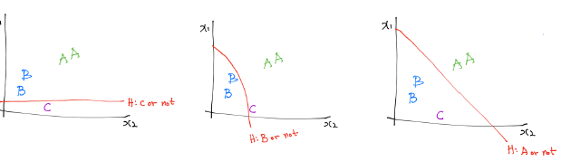
One vs All
Firstly, We can use technique called “One vs All”
Find three h(x)s, like “C or not”, “B or not” , “A or not”
So we can separate them by A,B,C grade.
But we must doing Binary Classification three times.
It is unefficient.

Slide 6
Softmax Classification
Firstly, We can use technique called “One vs All”
Find three h(x)s, like “C or not”, “B or not” , “A or not”
So we can separate them by A,B,C grade.
But we must doing Binary Classification three times.
It is unefficient.

Slide 7
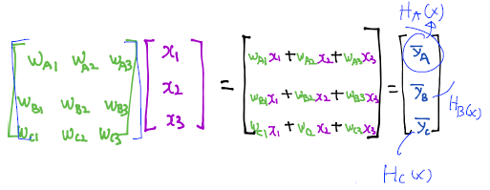
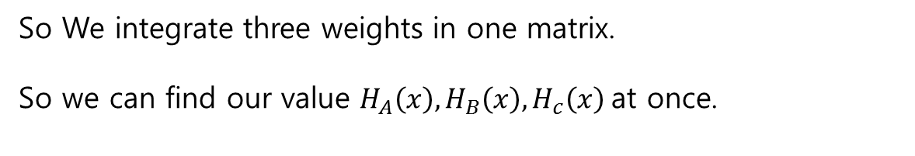
Softmax Classification
So We integrate three weights in one matrix.
So we can find our value $H_{A}\left(x\right), H_{B}\left(x\right),H_{c}\left(x\right)$at once.

Slide 8
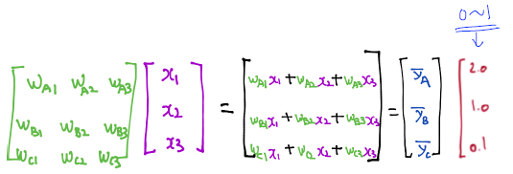
Softmax Classification
After that process,
Calculate sigmoid(h(x))
(in this example, 2.0 , 1.0, 0.1)

Slide 9
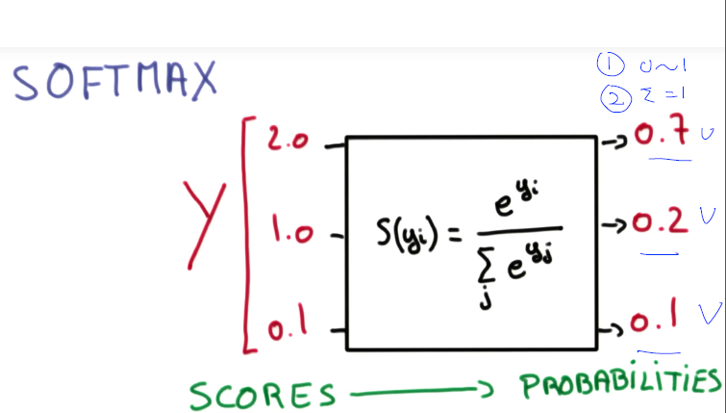
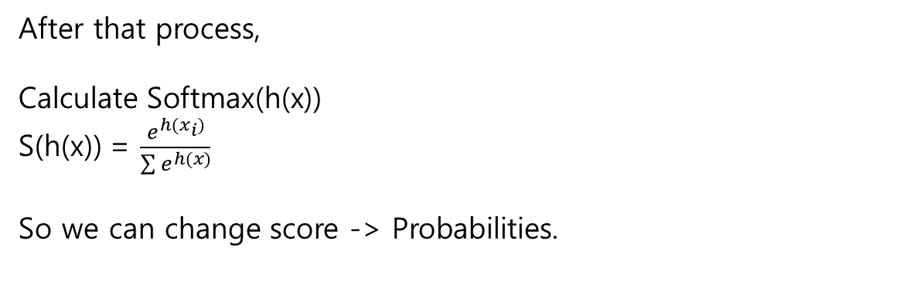
Softmax Classification
After that process,
Calculate Softmax(h(x))
S(h(x)) = $\frac{e^{h(x_{i})}}{\sum{e^{h(x)}}}$
So we can change score -> Probabilities.

Slide 10
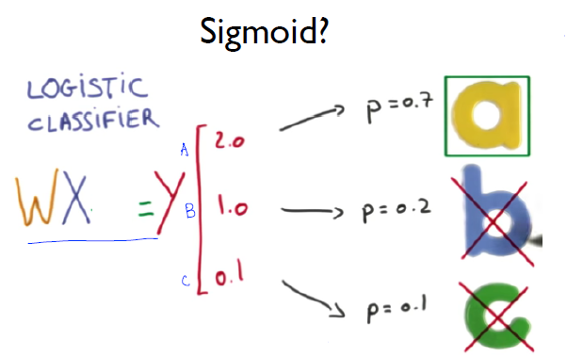
Softmax Classification
Like this, We can find Probabilities to be A, to be B, to be C
So sum of these probabilities are always ~ 1.

Slide 11
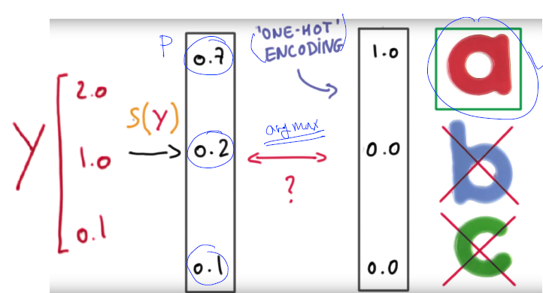
Softmax Classification
We can find our final predict value by One-Hot Encoding

Slide 12
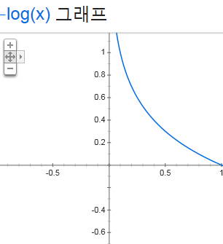
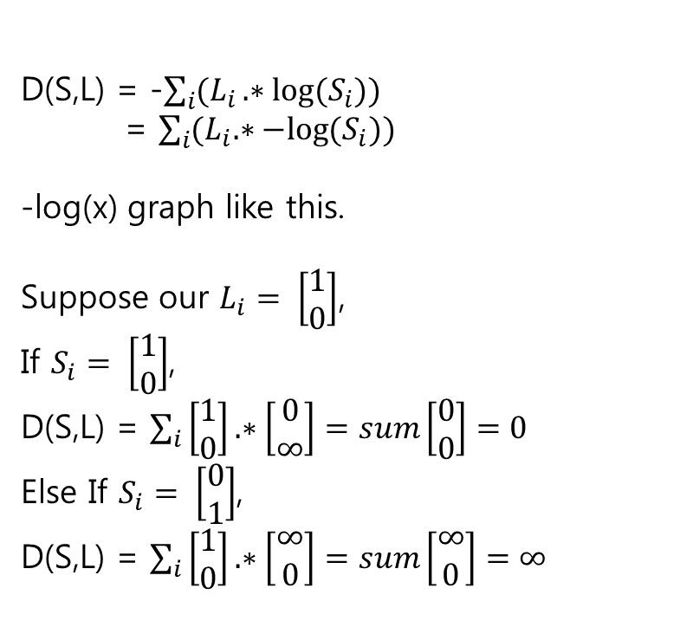
Cost Function in Softmax
D(S,L) = -$\sum_{i}{(L_{i}.∗log{{(S}_{i}))}}$
= $\sum_{i}{{(L}_{i}.∗−log{{(S}_{i}))}}$
-log(x) graph like this.
Suppose our $L_{i}= \left[\begin{aligned}1 \\ 0\end{aligned}\right]$,
If $S_{i}= \left[\begin{aligned}1 \\ 0\end{aligned}\right]$,
D(S,L) = $\sum_{i}{\left[\begin{aligned}1 \\ 0\end{aligned}\right].∗\left[\begin{aligned}0 \\ ∞\end{aligned}\right]}=sum\left[\begin{aligned}0 \\ 0\end{aligned}\right]=0$
Else If $S_{i}= \left[\begin{aligned}0 \\ 1\end{aligned}\right]$,
D(S,L) = $\sum_{i}{\left[\begin{aligned}1 \\ 0\end{aligned}\right].∗\left[\begin{aligned}∞ \\ 0\end{aligned}\right]}=sum\left[\begin{aligned}∞ \\ 0\end{aligned}\right]=∞$

Slide 13
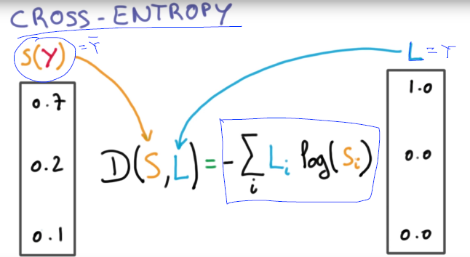
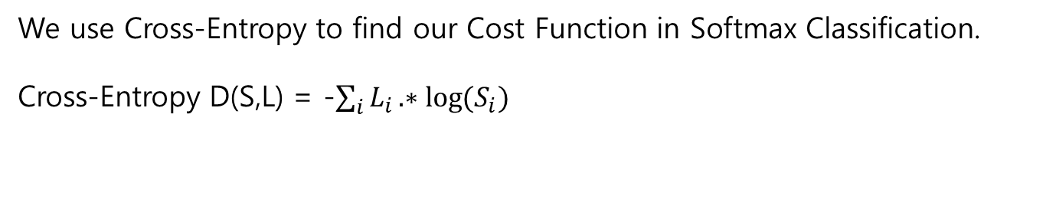
Cost Function in Softmax
We use Cross-Entropy to find our Cost Function in Softmax Classification.
Cross-Entropy D(S,L) = -$\sum_{i}{L_{i}.∗log{{(S}_{i})}}$

Slide 14
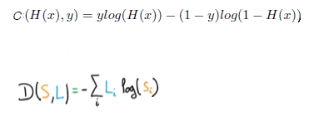
Softmax vs Logistic Regression

Slide 15
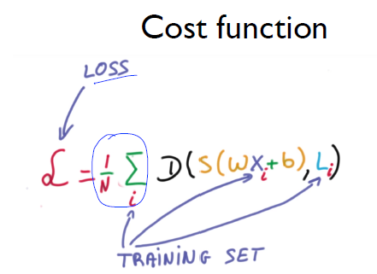
Cost Function in Softmax
So We can find Cost function by this formula.

Slide 16
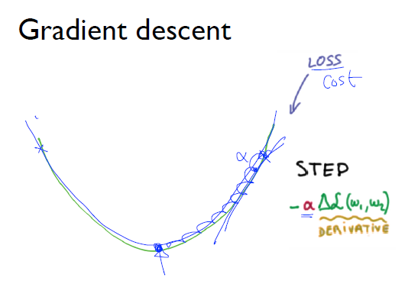
Gradient Descent in Softmax

Slide 17
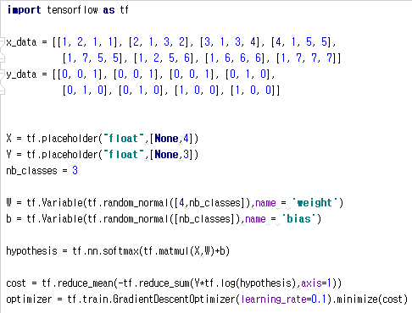
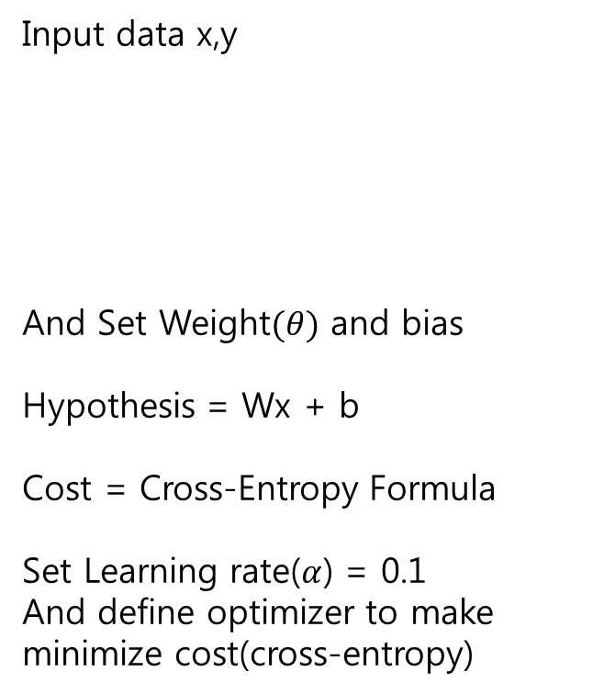
Programming Softmax by Tensorflow
Input data x,y
And Set Weight$(θ)$ and bias
Hypothesis = Wx + b
Cost = Cross-Entropy Formula
Set Learning rate($α$) = 0.1
And define optimizer to make minimize cost(cross-entropy)

Slide 18
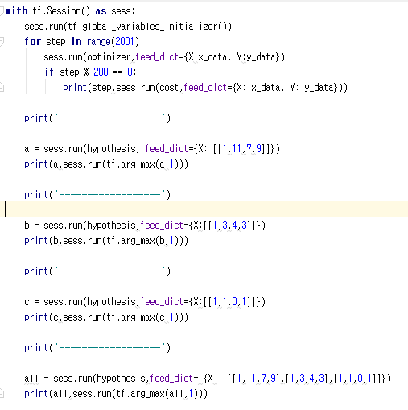
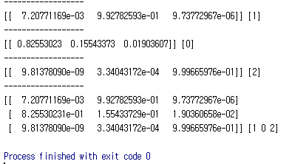
Programming Softmax by Tensorflow
Gradient Descent with 2000 iterations.
We can use tf.arg_max to find h(x). (this function return most big value’s index)
(Program Run Screenshot)

Slide 19
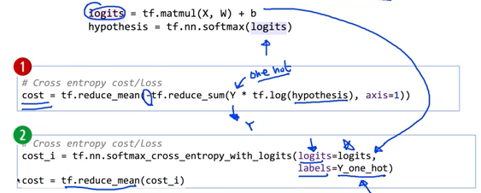
Programming Softmax More Fancy!
First program’s cost function is too complex.
So tensorflow support library to get cross entropy value.
We use logits instead of hypothesis.

Slide 20
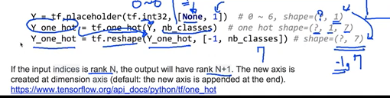
Programming Softmax More Fancy!
We can use tf.one_hot() for one-hot encoding.
But if we use one-hot, we must reshape Y_one_hot.
Because, one_hot add dimension.
Ex) [[0],[3]] -> [[[1000000],[0010000]]]

Slide 21
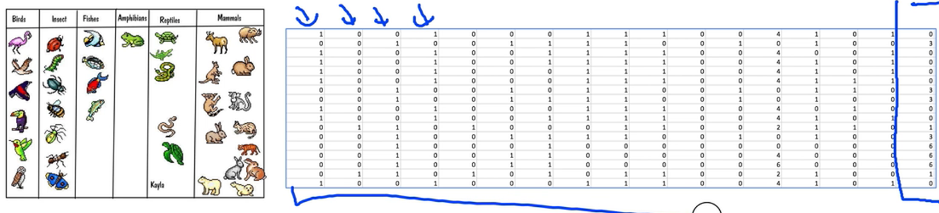
Programming Zoo Classifier

Slide 22
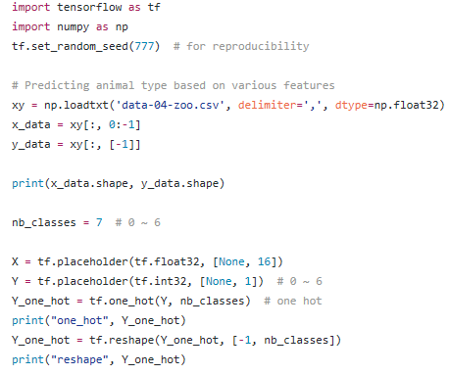
Programming Zoo Classifier
Load data(it has many feature about animal)
Ex) how many legs, has tail or hasn’t, etc..
And set nb_classes = 7.
We have 7 different animals class.
Doing One_hot encoding & reshape

Slide 23
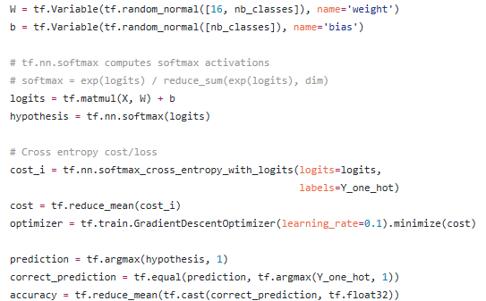
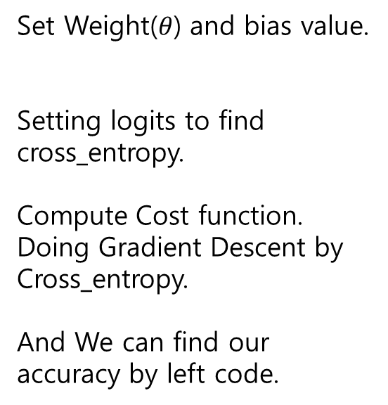
Programming Zoo Classifier
Set Weight($θ$) and bias value.
Setting logits to find cross_entropy.
Compute Cost function.
Doing Gradient Descent by Cross_entropy.
And We can find our accuracy by left code.

Slide 24
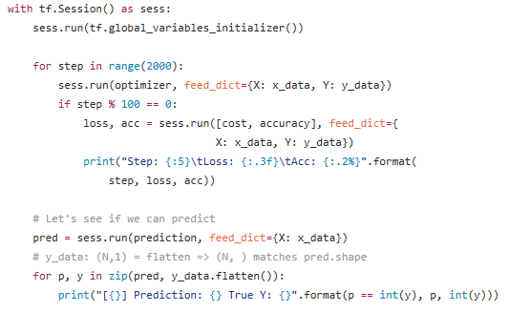
Programming Zoo Classifier

Slide 25
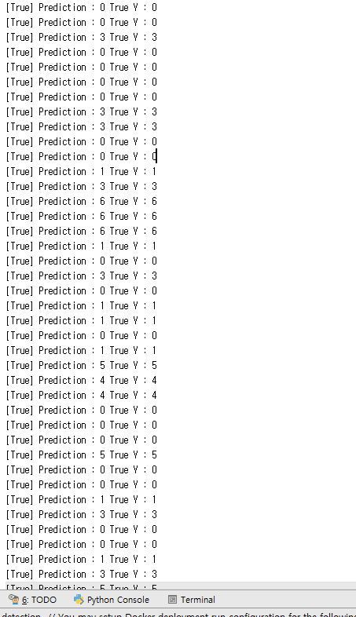
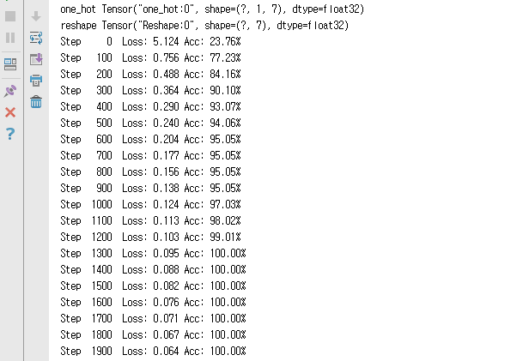
Programming Zoo Classifier Running Screen

Slide 26
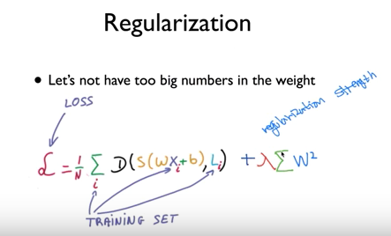
Regularization in Cross-Entropy
Same as other Algorithm.

Slide 27
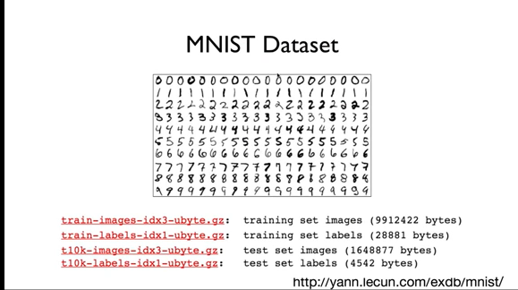
MNIST Dataset
To make computer can recognize character written by human.
(Post Number Recognize)

